Slide 1
MRA TAX PAYERS REGISTRATION SYSTEM
MILWARD KADZITAYE

Slide 2
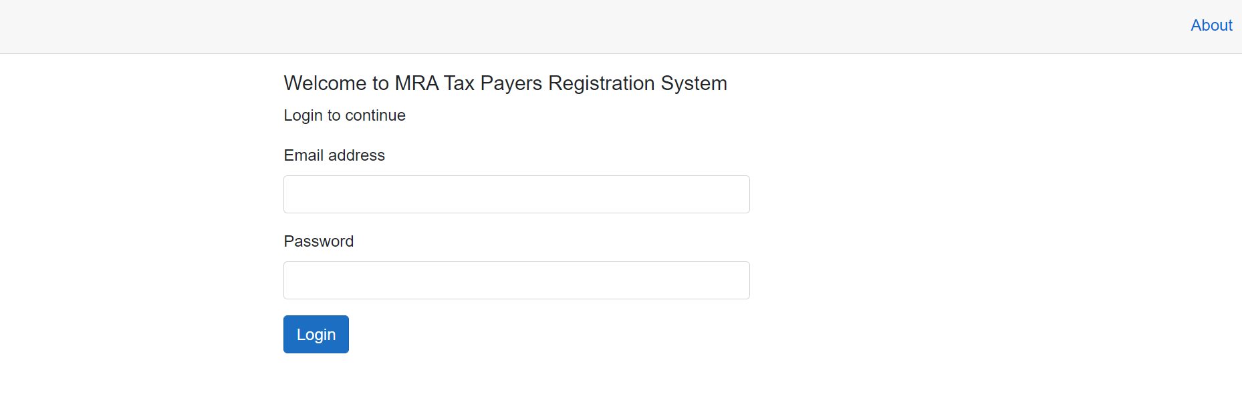
LOGIN SCREEN

Slide 3
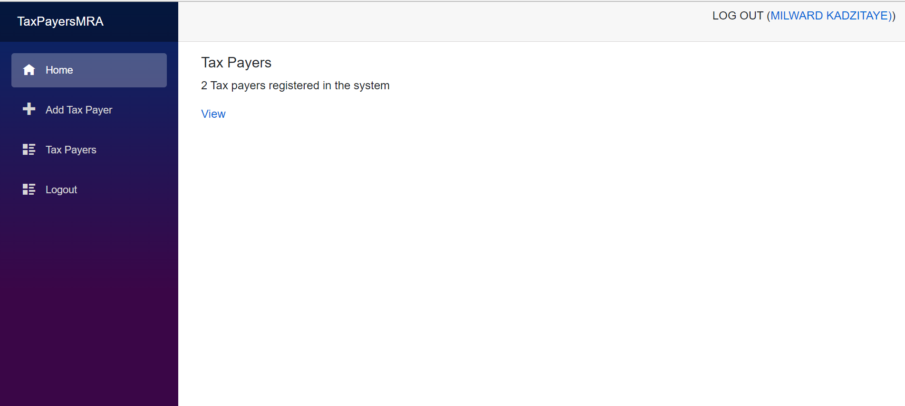
DASHBOARD

Slide 4
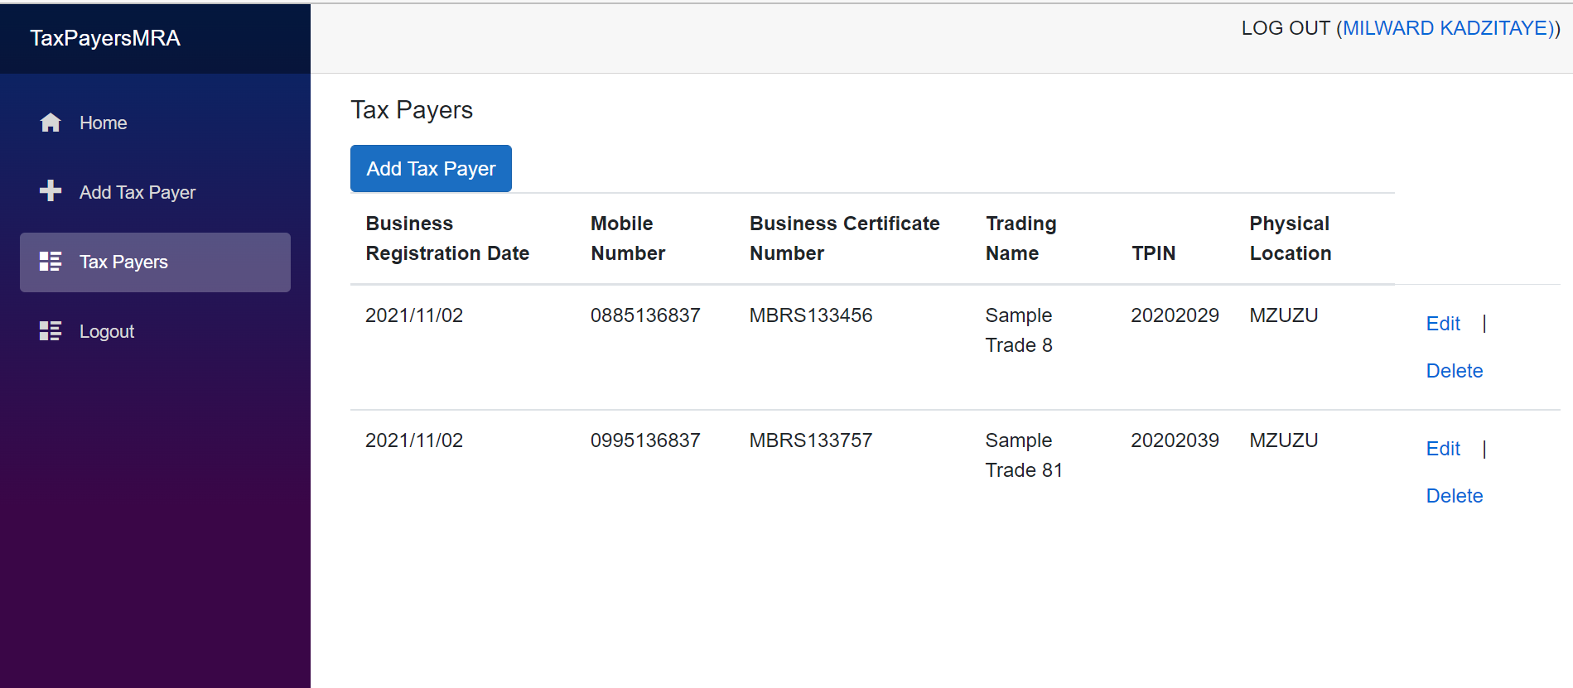
TAX PAYERS SCREEN

Slide 5
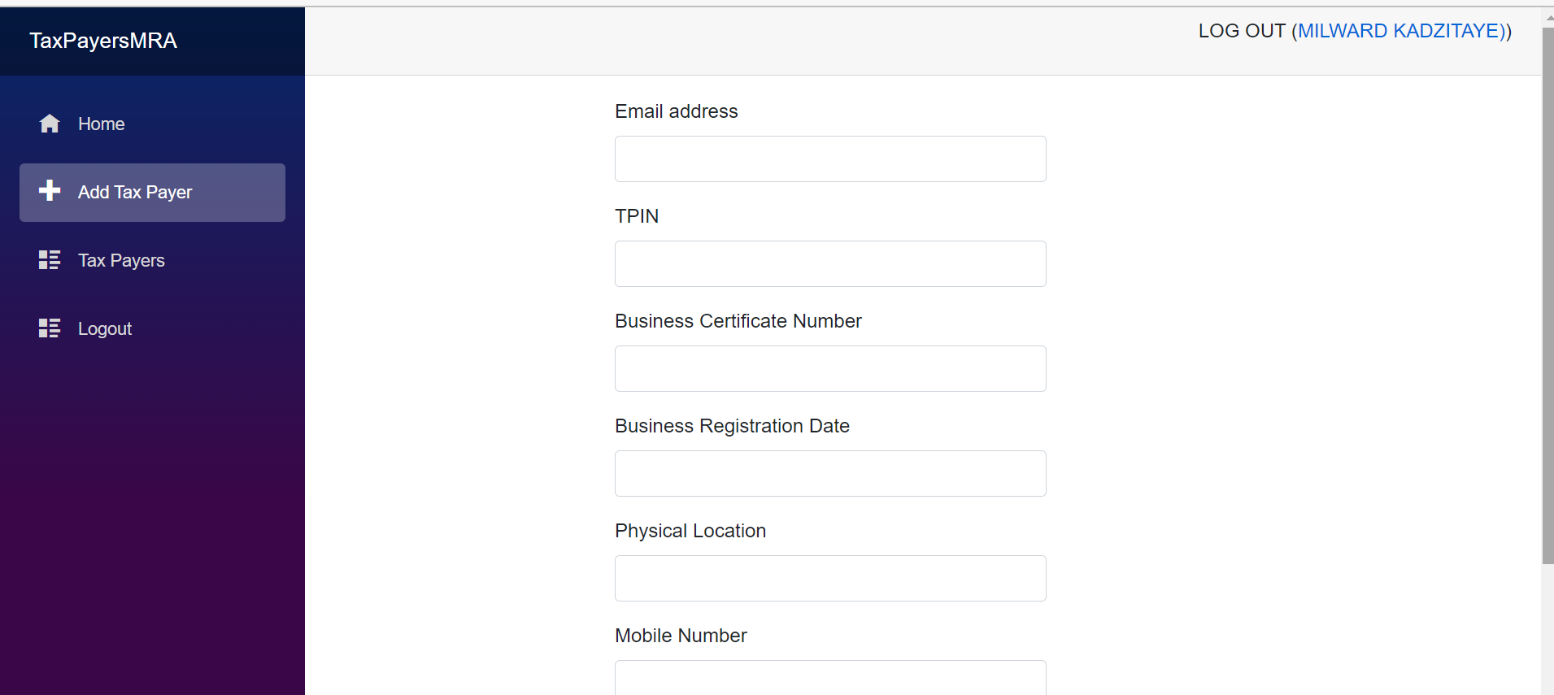
ADD TAX PAYER SCREEN

Slide 6
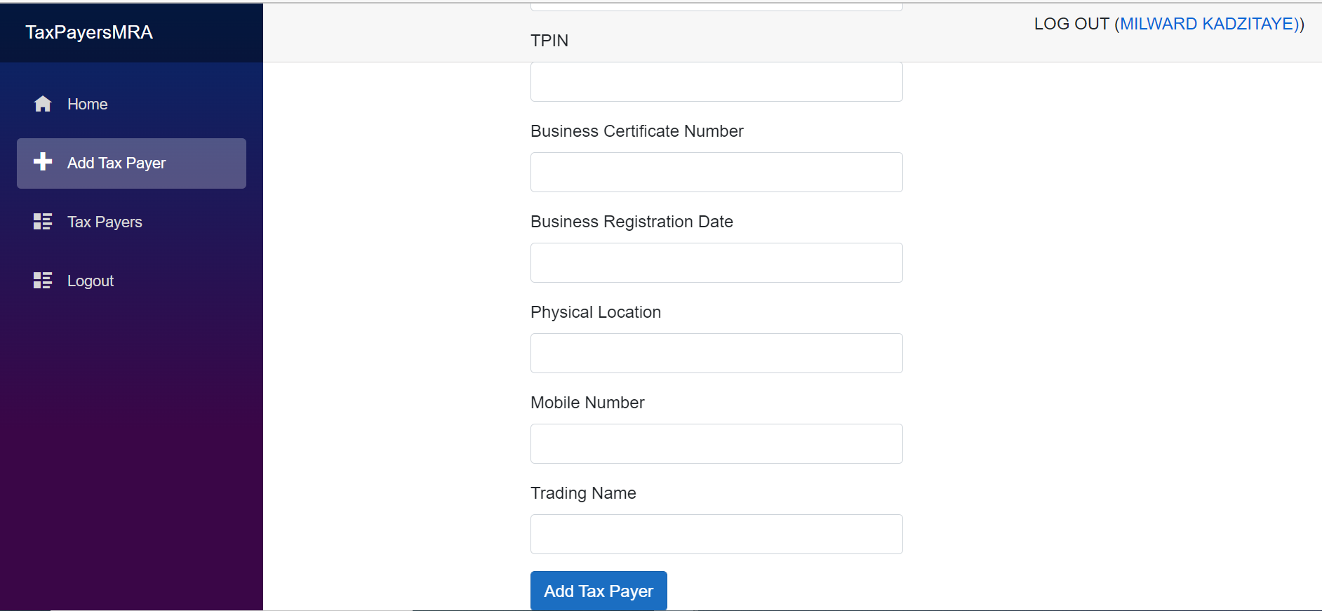
ADD TAX PAYER SCREEN cont.

Slide 7
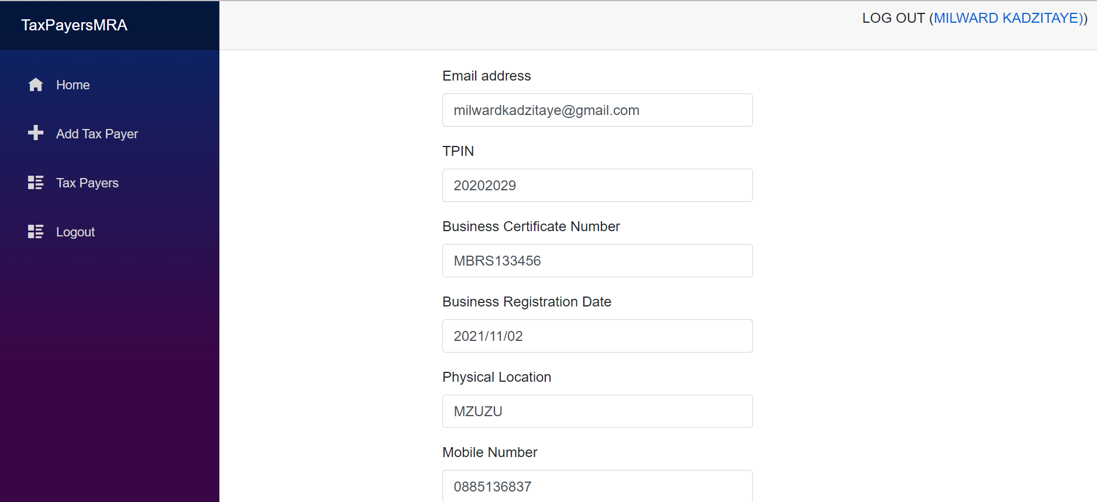
EDIT TAX PAYER SCREEN

Slide 8
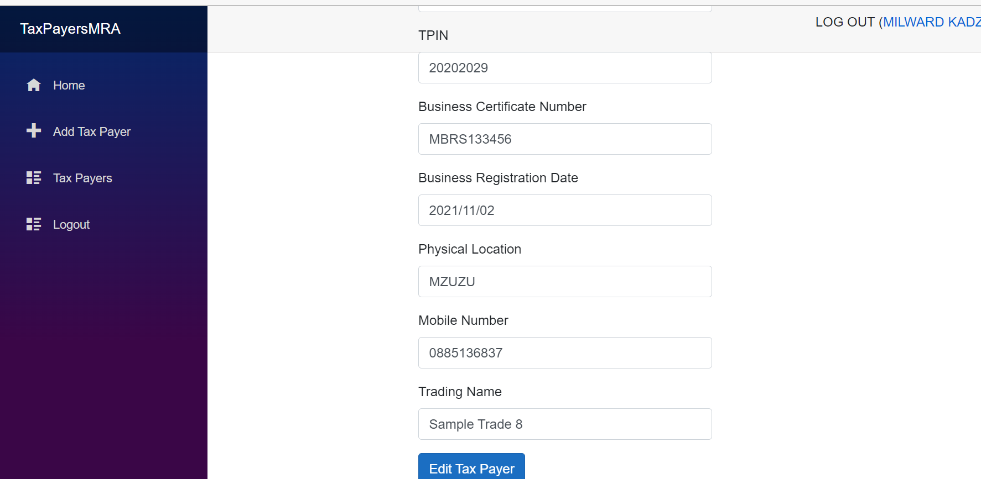
EDIT TAX PAYER SCREEN cont.

Slide 9
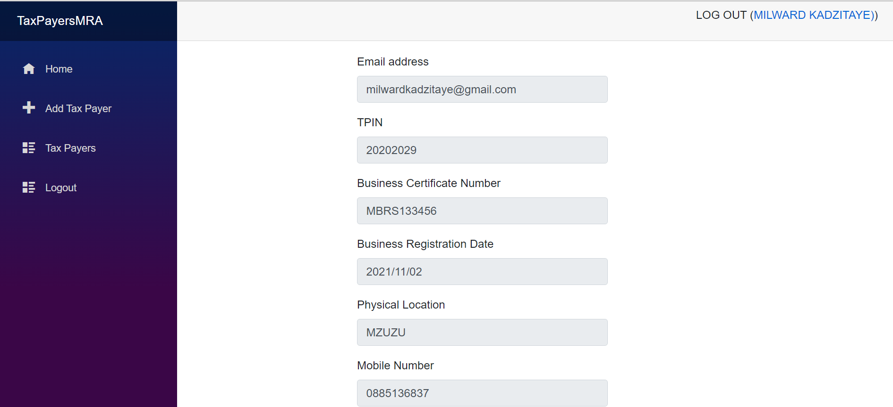
DELETE TAX PAYER SCREEN cont.

Slide 10
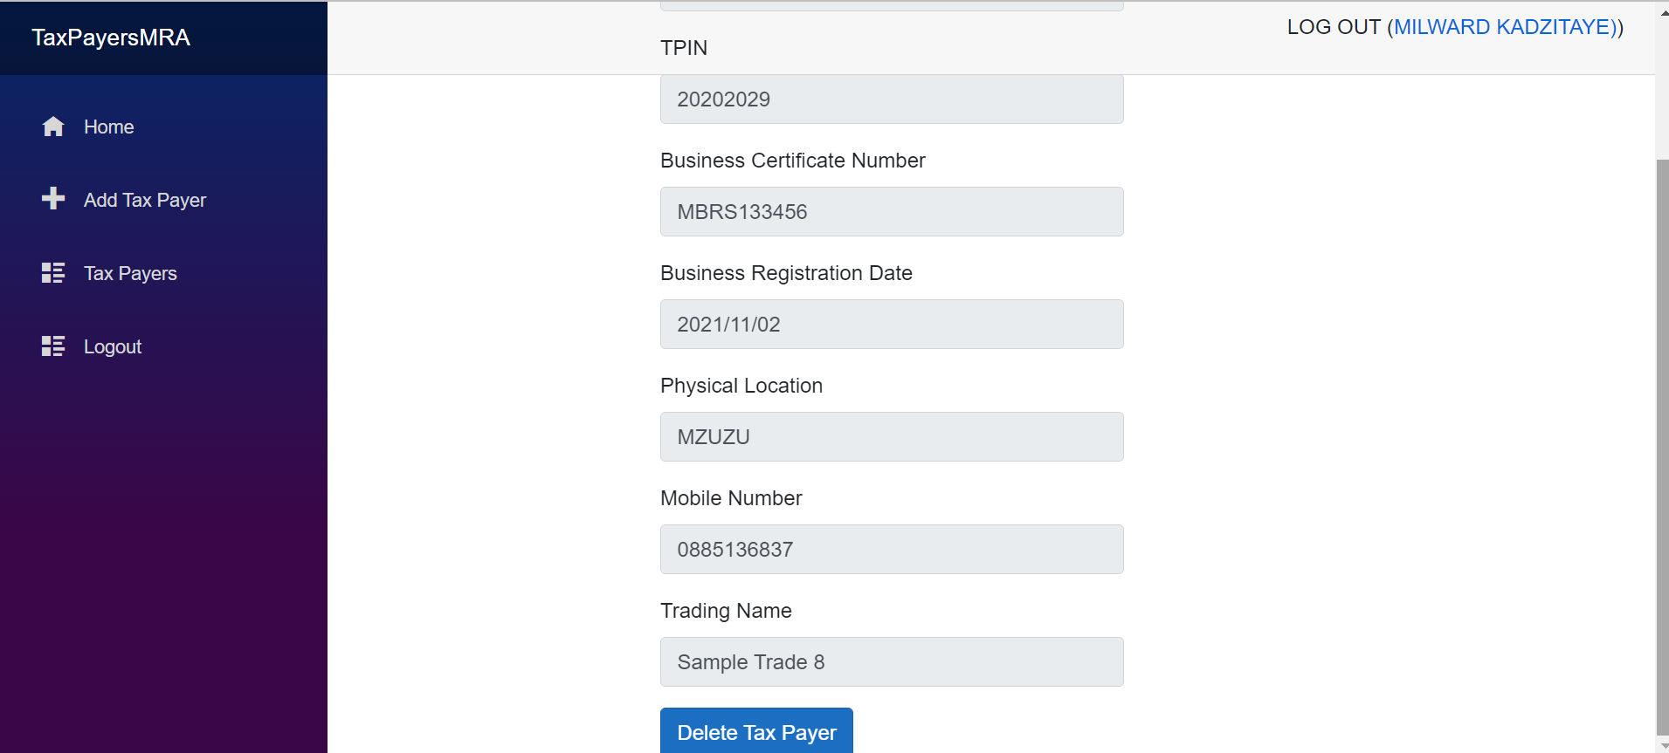
DELETE TAX PAYER SCREEN cont.

